Slide 1






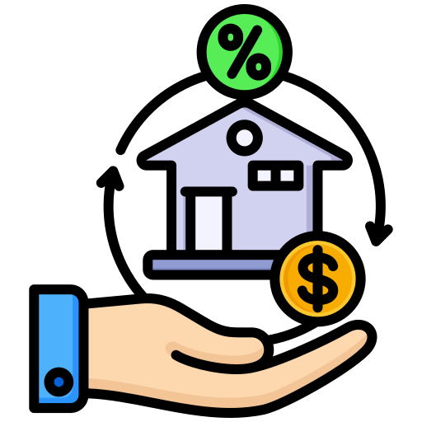
HIGH LEVEL DESIGN ARCHITECTURE
Database
Mobile Apps
API Server
Document Storage
Authentication Service
Notification Service
Loan Service

Slide 2
HIGH LEVEL DESIGN ARCHITECTURE

Slide 3
HIGH LEVEL SCREEN FLOW

Slide 4
REGISTRATION SCREEN FLOW

Slide 5
LOGIN & DASHBOARD SCREEN FLOW

Slide 6
LOAN PROCESS SCREEN FLOW

Slide 7
ENTITY RELATIONSHIP DIAGRAM

Slide 8
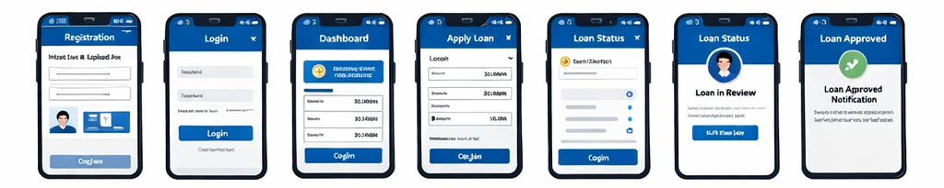
SCREEN BEHAVIOR

